Slide 1
Asynchronous Programming

Slide 2
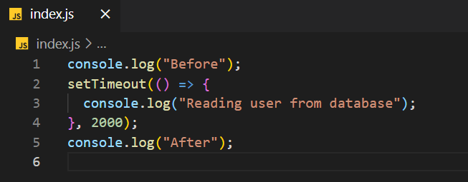
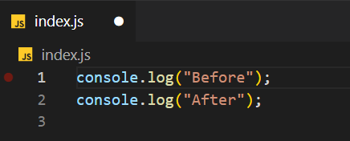
ASYNC VS SYNC
SYNC
ASYNC

Slide 3
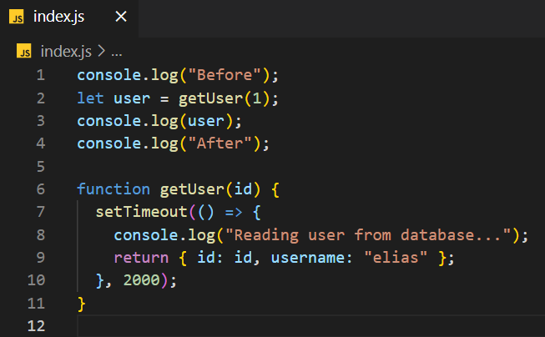
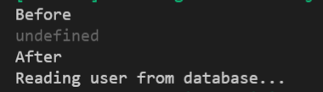
How to use ASYNC
The is three ways to work with ASYNC 1) Callbacks
2) Promises
3) Async/await
Output:

Slide 4
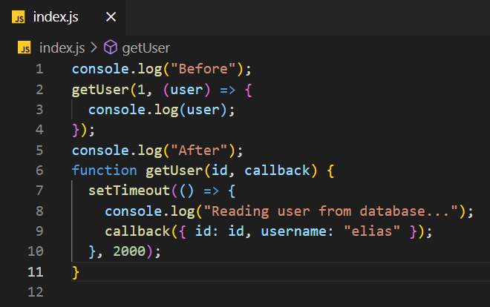
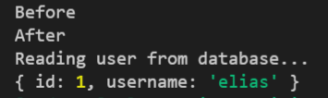
Callbacks
A function that we are going to call when the result, of an asynchronous operation is ready.

Slide 5
Question
Get students name implement method that using setTiemout and return array of students
Call this method and log all the student into the console.

Slide 6
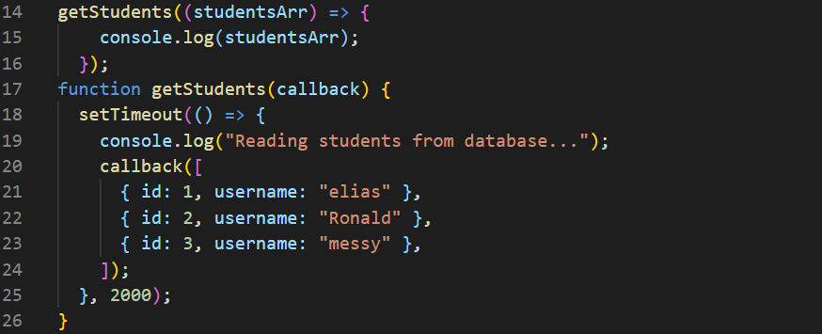
Answer

Slide 7
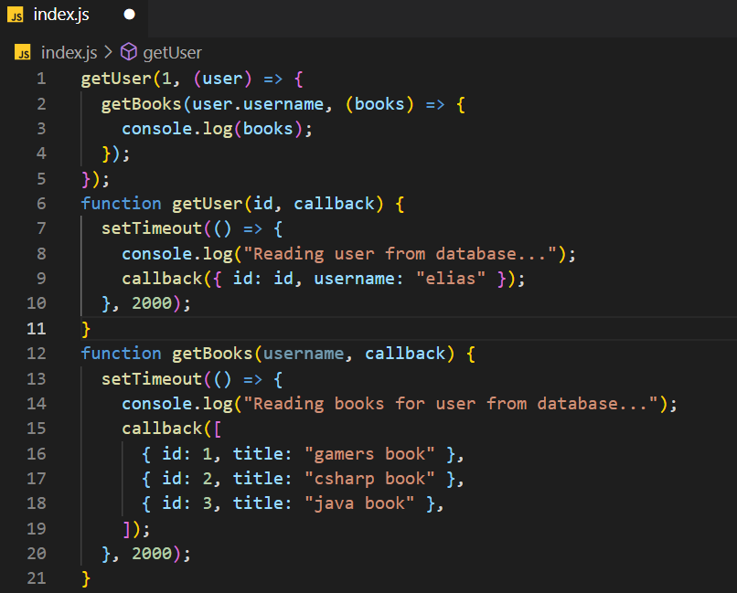
Callback Hell ~ Christmas tree problem
Nested structure in callbacks
As u can see when we have a lot o callbacks it become hell

Slide 8
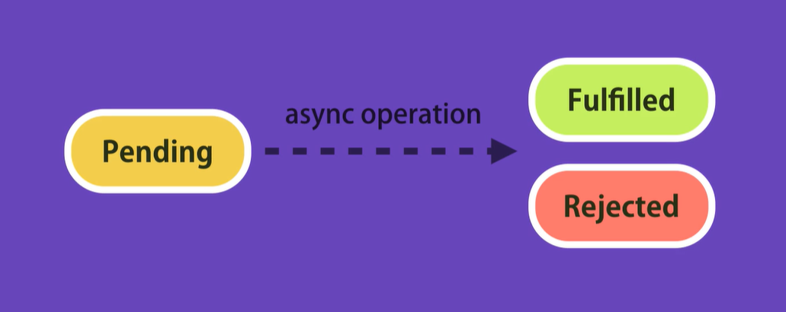
Promise
Promise definition: Holds the eventual result of an asynchronous operation
Promise have two results Fulfilled (success) and Rejected (failed)

Slide 9
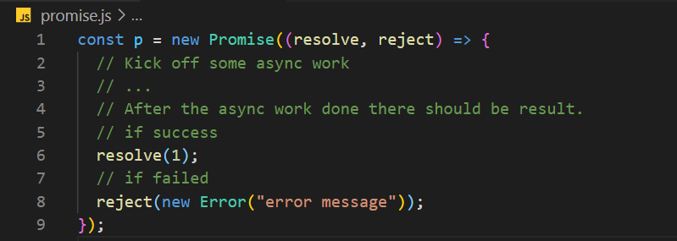
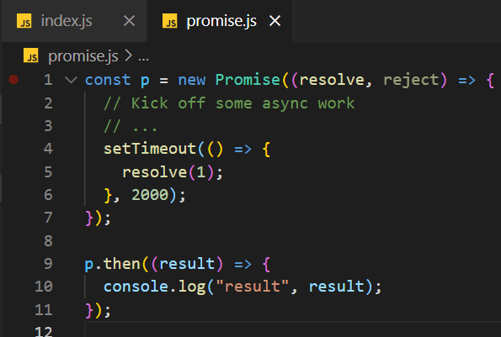
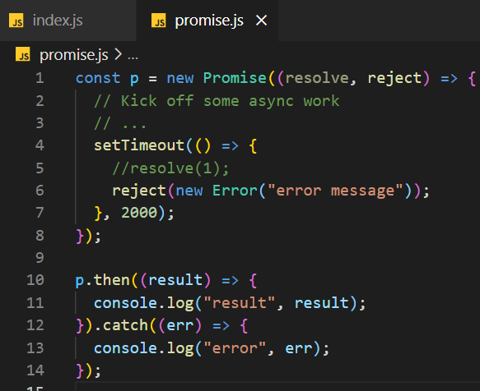
Promise

Slide 10
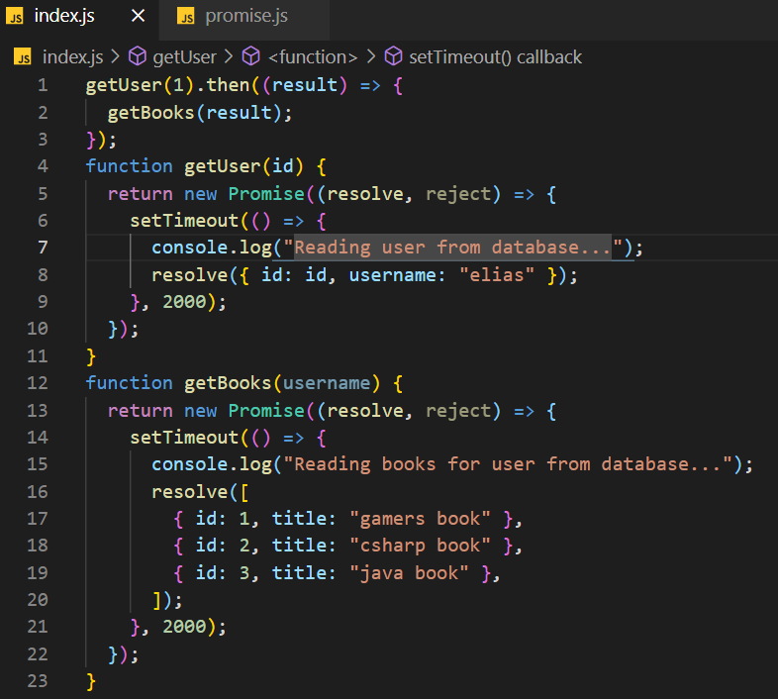
Replacing Callbacks with Promises

Slide 11

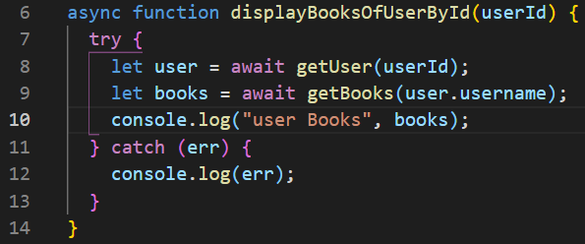
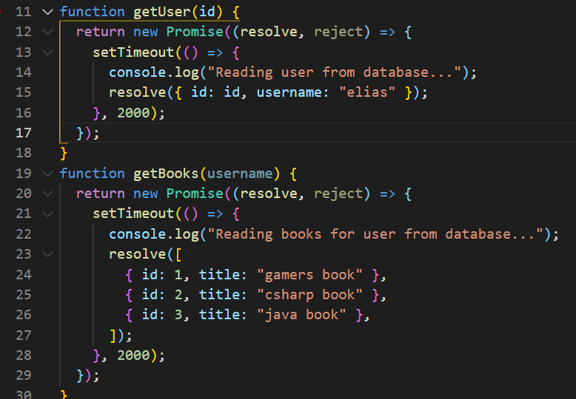
Async await
Promise example
Async await example

